Slide 1
Transition Relief and Ongoing Practical Expedients in IFRS 16 Leases A joint AASB-MASB project
Technical Session 7
Angus Thomson – MASB
Ao Li - AASB
Disclaimer This presentation provides the personal views of the presenter and does not necessarily represent the views of the AASB, MASB or other AASB and MASB staff. Its contents are for general information only and do not constitute advice. The AASB and MASB expressly disclaim all liability for any loss or damages arising from reliance upon any information in this presentation. This presentation is not to be reproduced, distributed or referred to in a public document without the express prior approval of AASB and MASB staff.

Slide 2
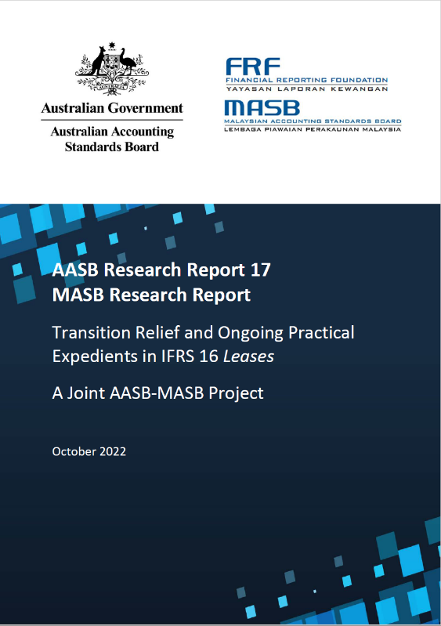
Contents
01
Objectives
02
Findings
03
Implications
Objectives
Transition relief and ongoing practical expedients in IFRS 16
Methodology
Stage 1 - Review of Disclosures
Stage 2 - Interviews
Future Standards
Next Steps

Slide 3
Objectives
Identify possible lessons that can be learned from implementing IFRS 16 that might prove helpful in identifying transition relief and ongoing practical expedients to be made available in future (new or amended) IFRS Accounting Standards
Contribute to the upcoming IFRS 16 Post-implementation Review

Slide 4
Transition relief and practical expedients in IFRS 16
Transition relief and ongoing practical expedients in IFRS 16
Definition of a Lease
Approach to Transition
Ongoing practical expedients
Apply IFRS 16 to all existing contracts classified as leases under IAS 17 and IFRIC 4
Full retrospective
Short term leases
Modified retrospective (i.e. cumulative catch-up)
Low value assets
Portfolio approach
Measurement of ROU assets
Not separating lease and non-lease components
Not reassessing existing contracts that are not leases under IAS 17 and IFRIC 4
Additional 5 forms of relief

Slide 5
Methodology - A two-stage approach
Questions
Stage 1 – Review of Financial Statement Disclosures
the extent to which the transition relief and practical expedients have been applied
01
50 ASX listed entities
35 Bursa Malaysia listed entities
reasons for lessees choosing to/not to apply
Stage 2 – Interviews
02
 | Australia | Malaysia
Preparers (Lessees) | 15 | 17
Users | 5 | 7
Auditors | 6 | 7
perceived usefulness of the transition relief and practical expedients
03
5

Slide 6
Stage 1 Review of Disclosures
Definition of lease
– 68% did not reassess
ROU measurement*
Approach to transition
– 89% modified retrospective
Option 1 only - 29%
Option 2 only - 38%
Option 1 and 2 - 33%
Additional 5 forms of relief
Ongoing Practical Expedients
Portfolio approach to discount rate
64%
Short term leases
98%
Previous Onerous Lease provision
57%
Low-value asset leases
99%
Leases less than 12m to run
96%
7%
Not separating non-lease components
Exclusion of initial direct cost
64%
1%
Portfolio Approach
Use of Hindsight
68%
*Option 1 - measure RoU assets at amounts determined as if IFRS 16 had been applied since the commencement date but discounted using the lessee's IBR at the date of initial application.
Option 2 - measure RoU assets at an amount equal to the lease liability, adjusted for any existing prepaid or accrued lease payments.

Slide 7
Stage 2 Interviews Preparers (Lessees)
Generally, very appreciative of the range of transition relief and ongoing practical expedients available based on the following consideration:
1
2
3
4
5
Availability of sufficiently skilled staff
Disproportion effort
Data availability
Volume & Size of Leases
Leases held by subsidiaries

Slide 8
Auditors
Clients’ use of transition relief and ongoing practical expedients was manageable
No abnormal audit concerns
Need to carefully plan the audit to ensure that no material errors arose

Slide 9
Users
Well-informed about the transition relief and ongoing practical expedients available to lessees
Understood the choices being made by entities they analysed
Familiar with the transition relief but not necessarily fully aware of the potential impacts on the information
Limited concerns about the comparability of financial statements
Appreciative of the level of disclosure that lessees are required to provide
A good balance between facilitating the application of IFRS 16 and providing useful information to users

Slide 10
Overall
The transition relief and ongoing practical expedients in IFRS 16 were useful by preparers, and auditors and users identified no major concerns.
Features contributing to the success include:
01
Pitched at reasonable level
02
Scale of application
03
Competing incentives
The transition relief and ongoing practical expedients have been pitched at a reasonable level
The scale at which the ongoing practical expedients can be applied.
The natural balance achieved by having competing incentives to either apply or not apply an ongoing practical expedient.

Slide 11
Implications
Likely starting point for reporting by the various IFRS stakeholders
Relief or expedients underpinned by countervailing incentives
Availability of suitably skilled staff around transition time
Potential flow-on effects which may not be immediately obvious
‘Bright lines’ transition relief and/or ongoing practical expedients
Users tolerance for and understanding of the relief or expedients
Flexibility around the scale of application
Communication around the possible material impact of any relief or expedient

Slide 12
Next Steps
Identify key policy decisions that would form the basis for a framework for proposing and concluding transition relief and ongoing practical expedients
Identify opportunities for communicating the impacts of transition relief and ongoing practical expedients to users
Considering the role of materiality in determining transition relief and for ongoing practical expedients
Research transition relief and policy choices available in other IFRS Accounting Standards
Follow up research on the application of ongoing practical expedients in IFRS 16

